Slide 1
WHAT FRIENDS ARE FOR

Slide 2





Story
$150
$160
$5
Install Solar
Research,
Info overload
confusion,
….
procrastination
Reached
out to
friends
Am I the only one having this issue?

Slide 3

Research
7 out of 8 had challenges and frustrations finding a provider
6 out of 8 reached out to their friends’ network
Insights:
problem is not just with tradies
How are they reaching out to friend's circle?

Slide 4
What are people doing
Text
WhatsApp groups
FB/Insta groups
Local communities
Important observation
it's not just about the direct friends, but it more powerful with friends of friends
Is there any problem or friction with these?

Slide 5

Personas and Problems
Movers and shakers
Mums in charge
Useless dads
Worried students
Their fear and problems:
Untrustworthy reviews
Don’t want to bother
Timely responses
How do we solve this problem?

Slide 6

Solution
Word of Friends
Mobile platform for recommendations of service providers from trusted friends' circles

Slide 7
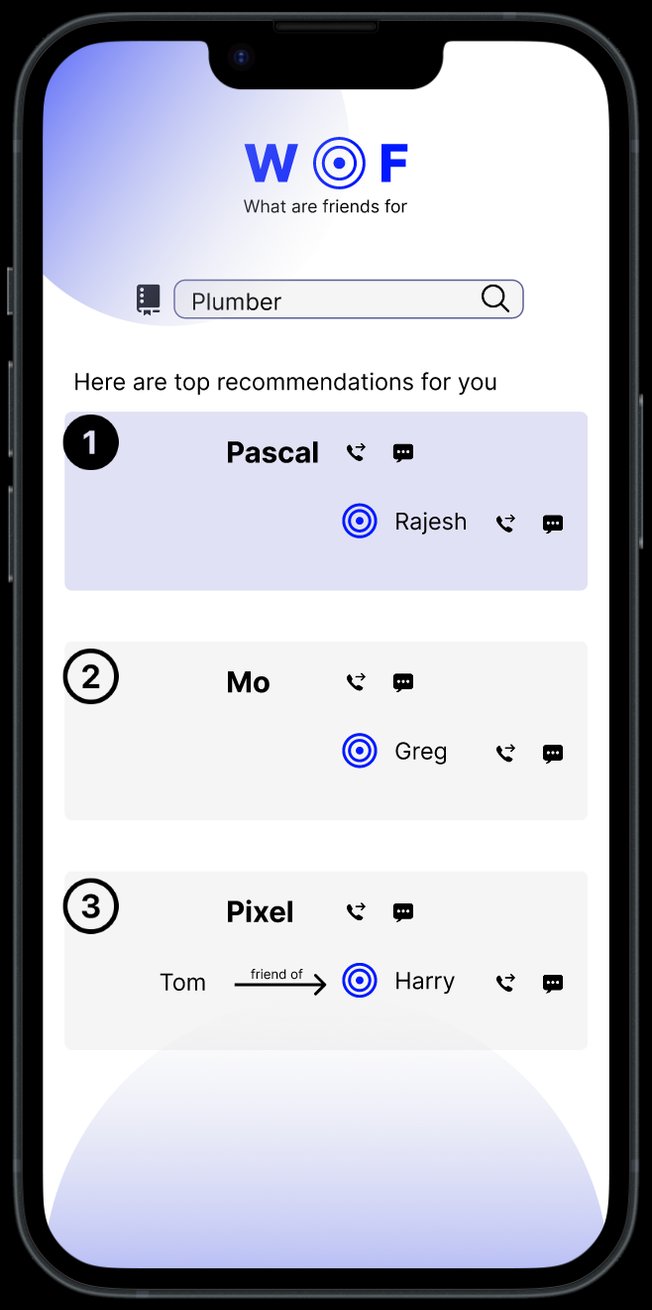
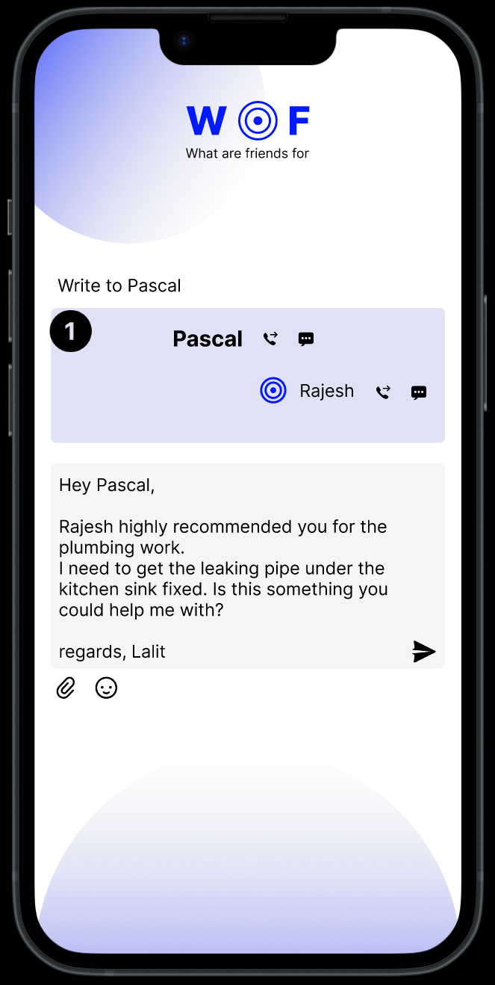
prototype

Slide 8



Secret sauce
Install App
Tap friend’s network through
phonebook
Recommendation AI
Tradie directory
Data and privacy is of critical importance to us.
Your data stays on your phone.
Are we the only one to provide a solution?

Slide 9







Competitive landscape
Direct Competitors
Indirect Competitors
How big is the market?

Slide 10
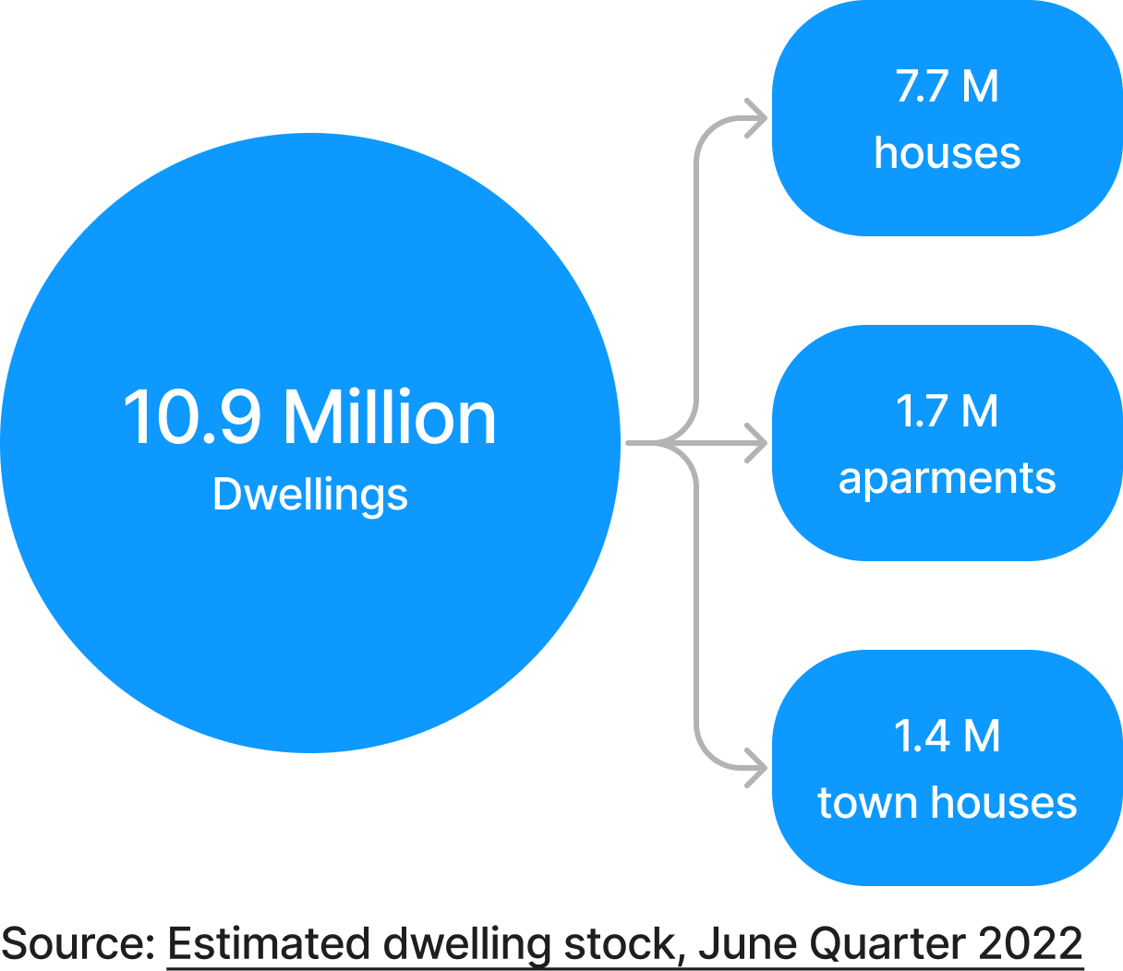
Market
5.5 M
Owner occupied
$200M+
Hipages - $62M
Airtasker - $45M
ServiceSeeking - $5M
…
What is our business model?

Slide 11

Business model
Commission on booking appointments
Subscription
Ad
Packaged recommendations
White labelling
X
From providers
= (No. of providers) X (No. of bookings) X (% commission)
So what's the roadmap

Slide 12
Roadmap
1,000,000
5000
50,000
Users
100
Working App
1 City
3 categories
8 Cities
3 categories
Expand categories
electrician
gardeners
aircon
outdoor landscaping
indoor renovator
Handyman
Pest control
Cleaners
Security (cams etc.)
Car repair
….
MVP
Sydney
Melbourne
Brisbane
Perth
Hobart
Adelaide
Canberra
Darwin
Tradie
Hairdressers
GPs

Slide 13
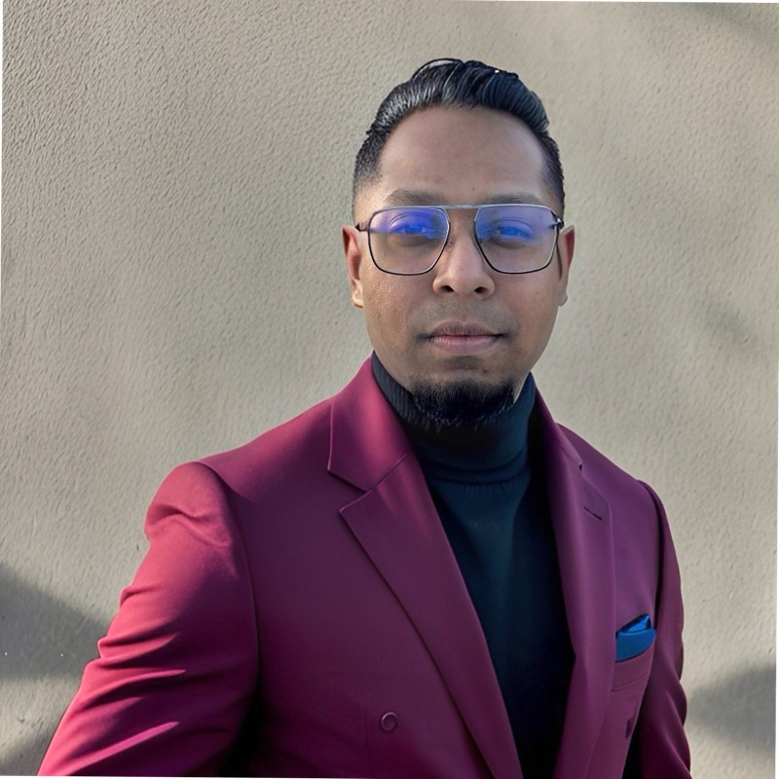
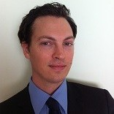
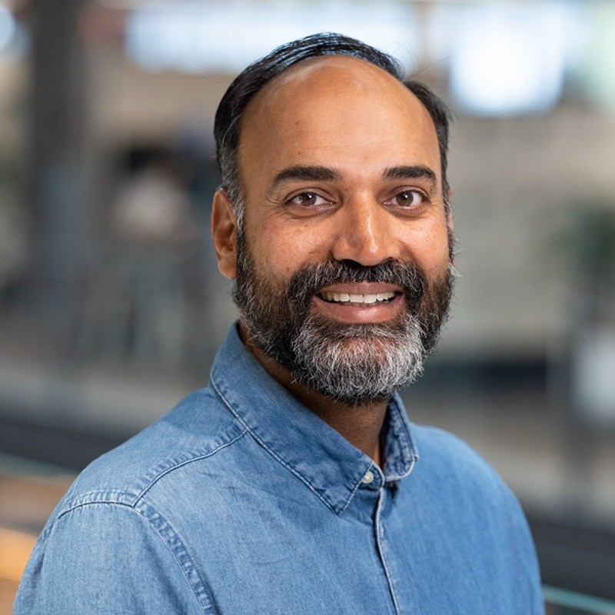
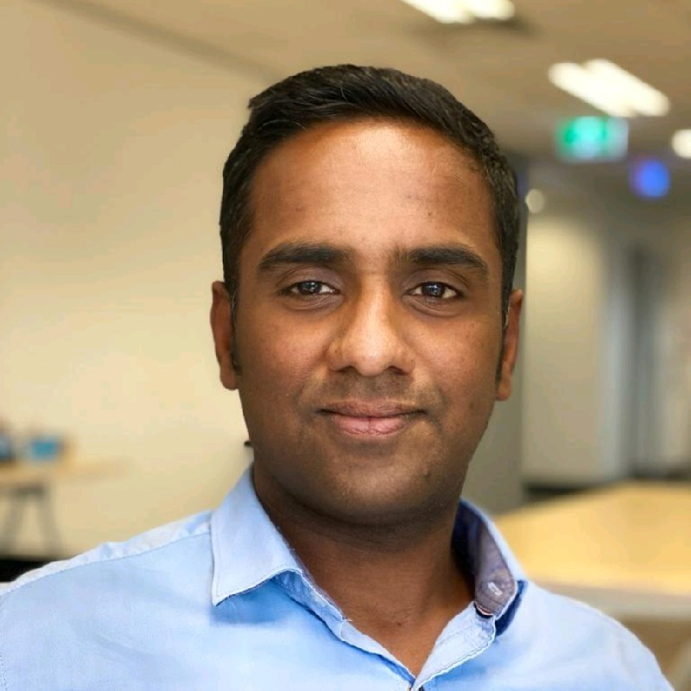
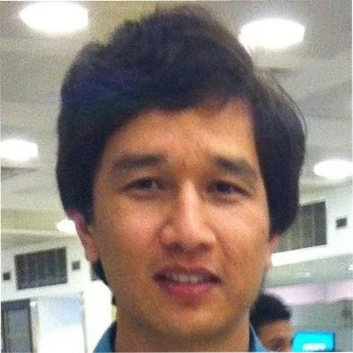
team
Asif Hossain
Gregory Corbisier
Lalit Parkale
Rajesh Joseph
Mehdi Faizy
Show me the money
Doer
Researcher
Bring people together
AI

Slide 14

WHAT FRIENDS ARE FOR

